Slide 1
Total Internal Reflection

Slide 2
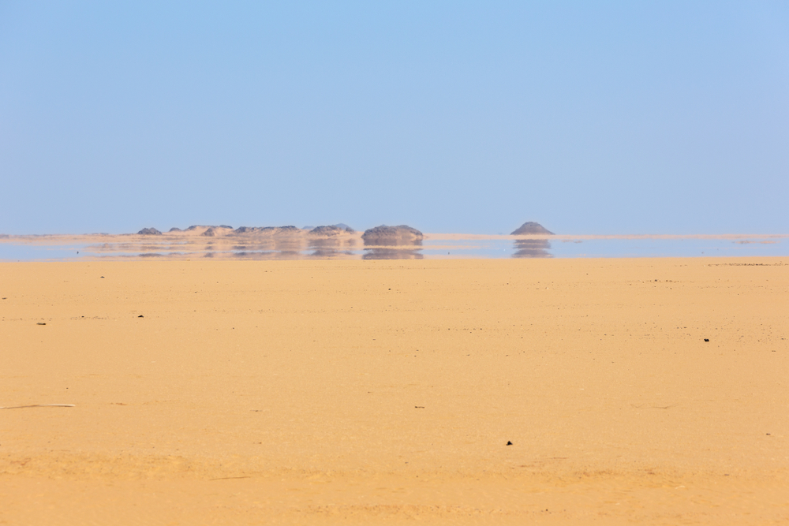
By the end of this lesson, you should be able to:
Describe total internal reflection.
Use Snell’s Law to calculate the critical angle.
Explain some applications of the critical angle.

Slide 3
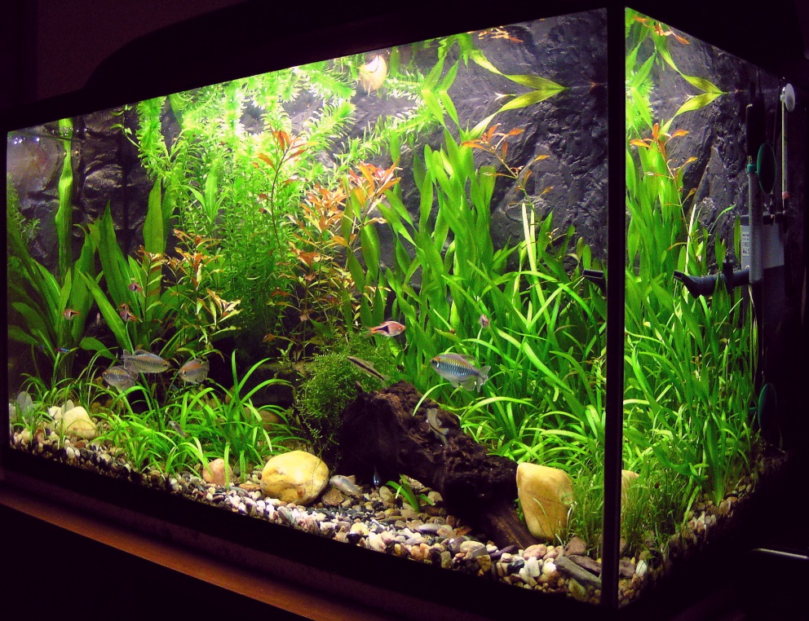
Have you ever looked at the surface of water from underneath?
You can see it in fish tanks, at the pool or at the beach: things under the water are reflected underneath the surface.
In previous lessons, we have treated light as though it can only reflect or only refract at the boundaries between mediums. However, this isn’t always the case.
In this picture of an aquarium, you can see light being transmitted (and refracted) down through the surface of the water, but you can also see reflections on the underside of the water. Why does this happen? Read on to find out.

Slide 4
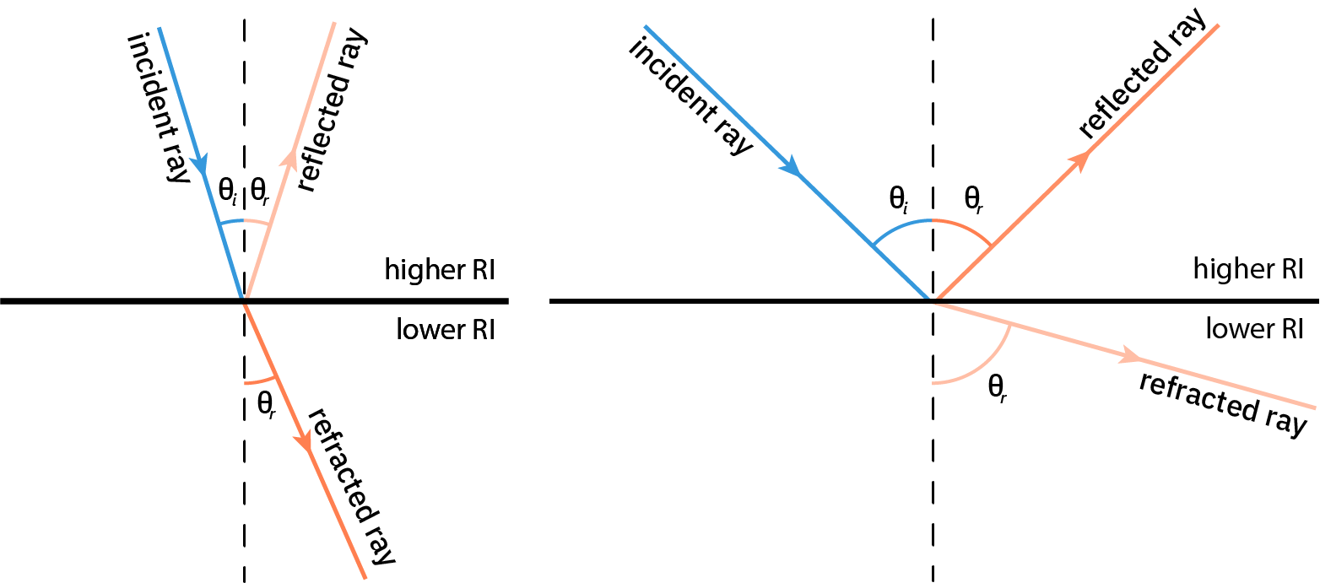
When light reaches the boundary between mediums, some light is reflected and some light is refracted.
The intensity of the reflected and refracted rays vary. At angles of incidence close to the normal, most light passes through the boundary and is refracted. As the angle of incidence increases, there is less refraction and more reflection.
The angles of reflection and refraction are not equal. The angle of reflection is equal to the angle of incidence, whereas the angle of refraction follows Snell’s Law.

Slide 5
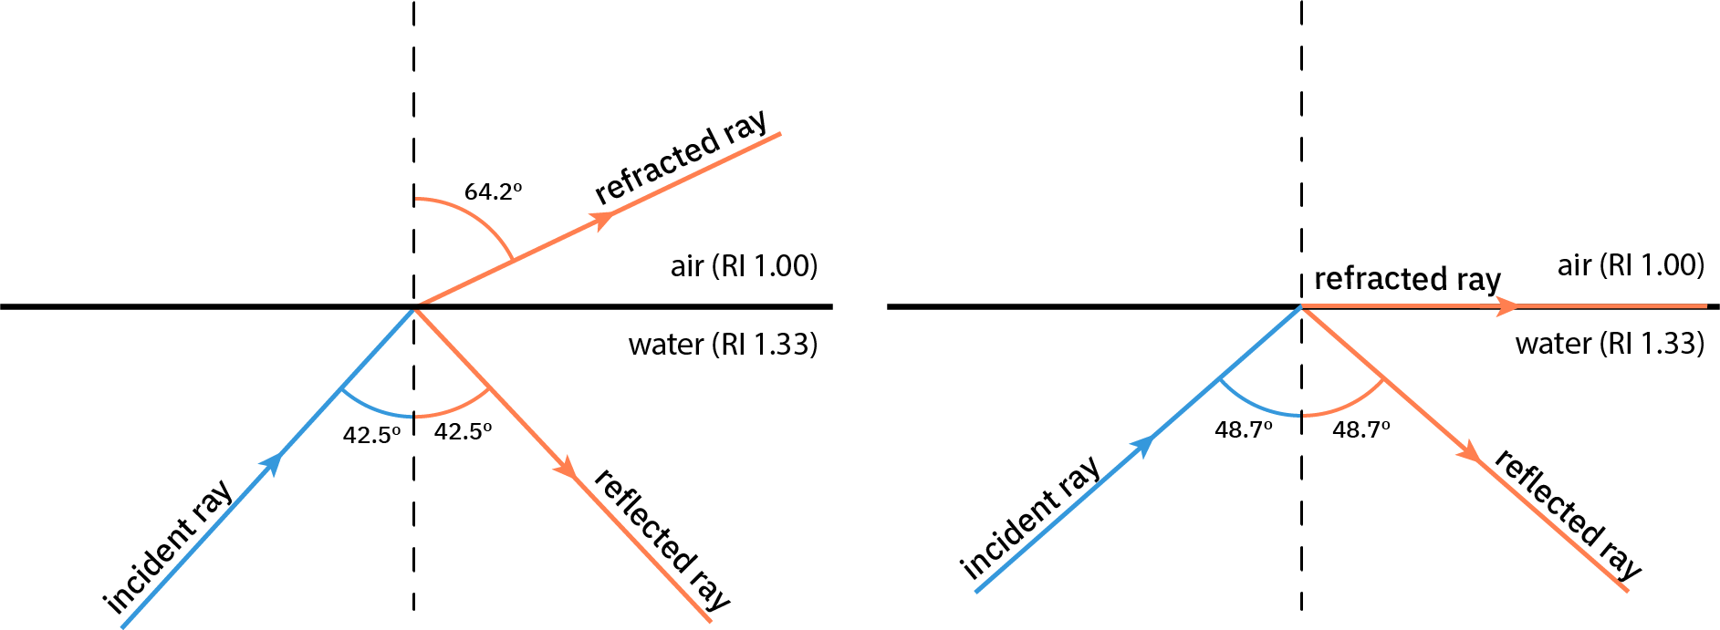
When light travels from a medium with a higher refractive index to a medium with a lower refractive index, it slows down and bends away from the normal.
The angle of refraction is therefore greater than the angle of incidence. The greater the angle of incidence, the greater the angle of refraction. But eventually, then, the angle of refraction must reach 90∘.
That means the refracted ray is travelling along the boundary between mediums! And we can increase the angle of incidence still further . . . what happens then?

Slide 6
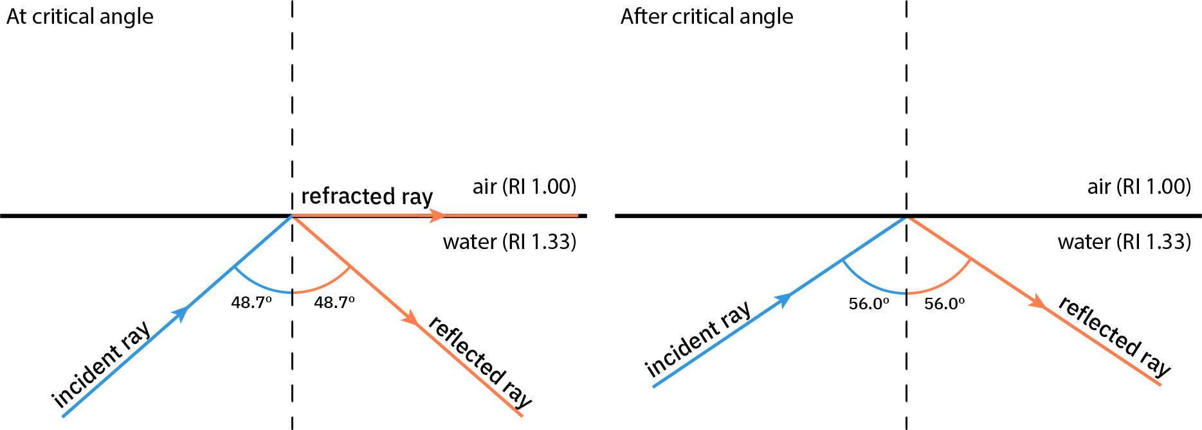
When the angle of refraction is 90º, the angle of incidence is called the critical angle.
Before the critical angle, some light is refracted and some is reflected. At the critical angle, the refracted ray travels along the boundary. Beyond the critical angle, light is no longer able to pass out of the denser medium.
Thus, past the critical angle all light is reflected back into that medium, and no refraction occurs. This is called total internal reflection.

Slide 7
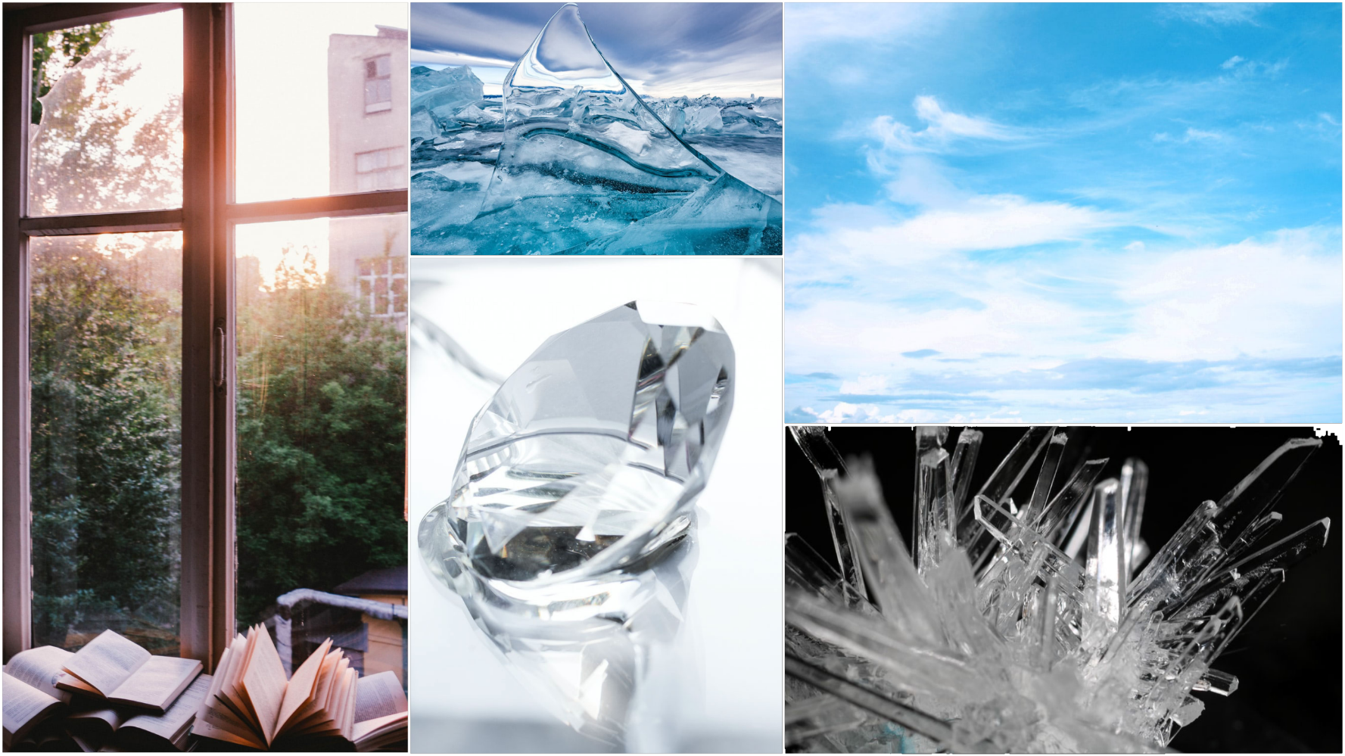
The critical angle varies depending on the refractive indices of the two mediums.
The greater the difference between the refractive indices of the two mediums, the lower the critical angle. Thus, a greater difference between refractive indices makes it easier for total internal reflection to occur.
In fact, the relative refractive index (remember, this is the ratio of one absolute refractive index to another) is inversely proportional to the critical angle.

Slide 8
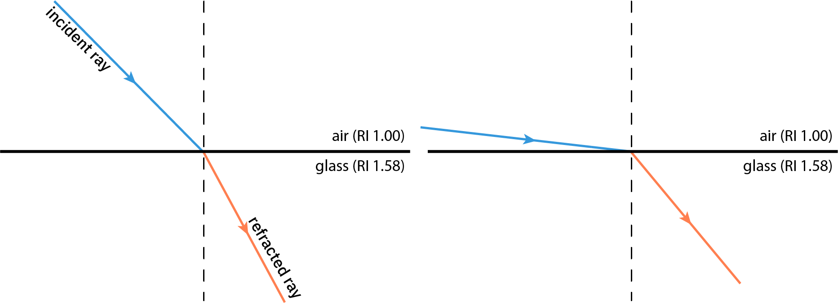
Total internal reflection can only occur when light passes from a medium with a higher refractive index into one with a lower refractive index.
When light passes into a medium with a higher refractive index, the angle of refraction is smaller than the angle of incidence. The angle of refraction increases as the angle of incidence increases, but it can never grow larger than the angle of incidence. This means that in this situation it is impossible to reach the critical angle. The angle of incidence will reach 90∘ before the angle of refraction can.

Slide 9
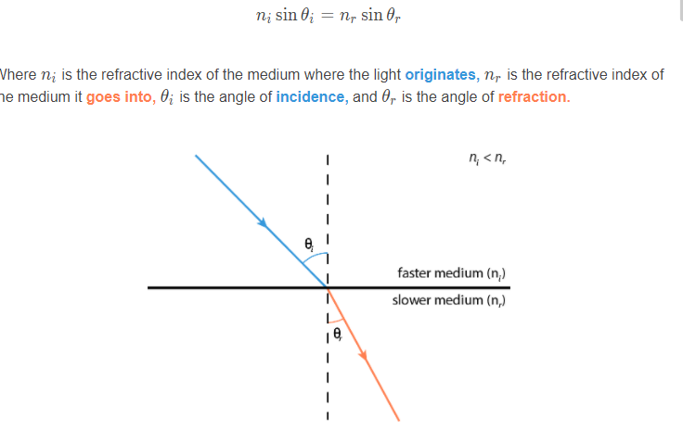
The critical angle can be calculated using Snell’s Law.
Remember, Snell’s Law relates the sines of the angles of incidence and refraction to the refractive indices. The Snell’s Law equation we are interested in here is:

Slide 10
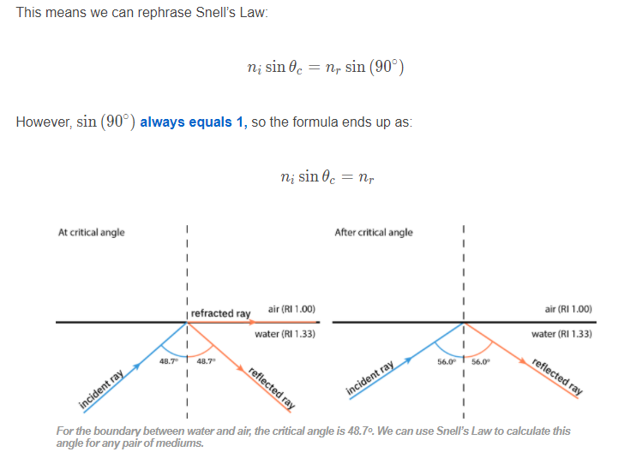
For total internal reflection to occur, certain conditions must be met.
The light is travelling from a denser to a less dense medium.
The angle of incidence must be greater than the critical angle.
At the critical angle (θc​) the angle of refraction is 90∘.

Slide 11
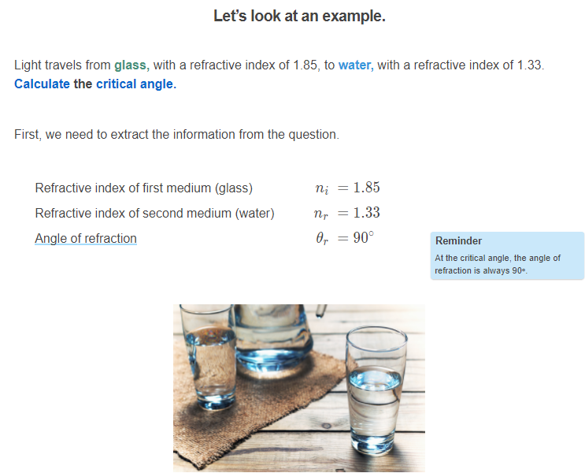

Slide 12
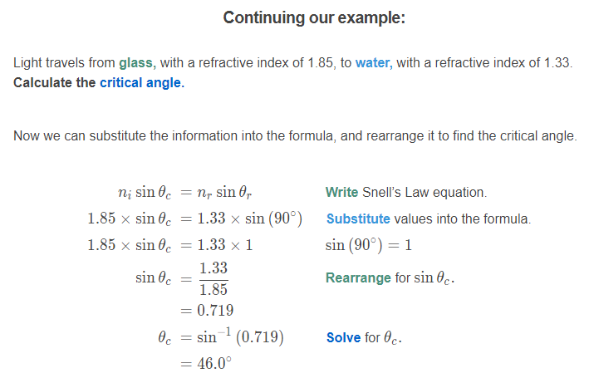

Slide 13
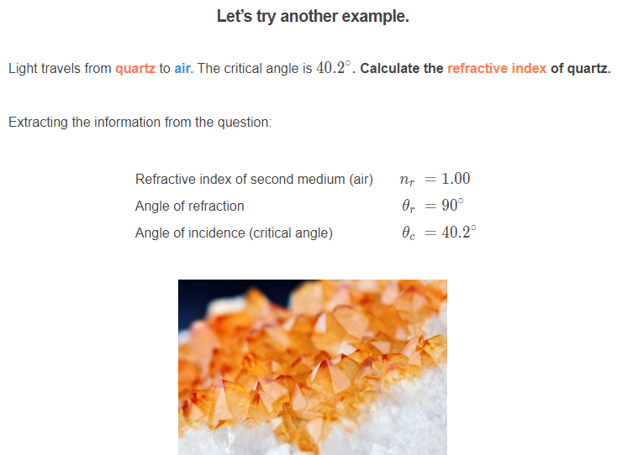

Slide 14
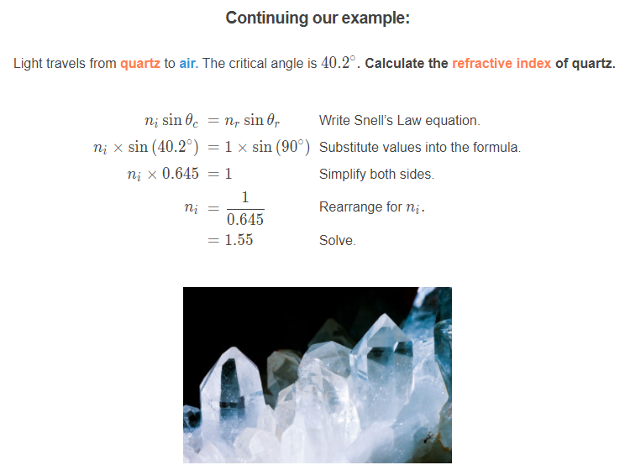

Slide 15

While it might not seem immediately obvious, total internal reflection has a lot of applications in everyday life.
You might have guessed that the reflections underneath the surface of the water in an aquarium we mentioned earlier are a result of total internal reflection. Light coming from under the water reflects off the surface and reaches your eye.
In this section, we’ll discuss some other places you might encounter total internal reflection.

Slide 16
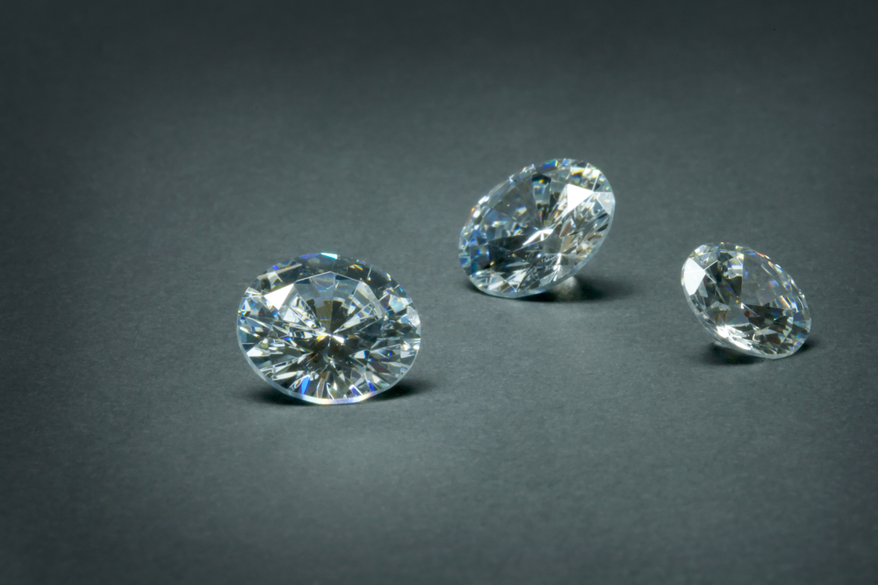
Have you ever wondered why diamonds are so sparkly?
The answer is total internal reflection. Diamond has a very high refractive index (2.42), so the critical angle for the interface between diamond and air is only 24.4∘. This means that when light enters a diamond, it’s difficult for it to leave (as it must exit at an angle less than 24.4∘).
When diamonds are cut, the facets are designed to make achieving this angle unlikely. Thus, the light only exits them in certain places, so it is intense in these places.

Slide 17
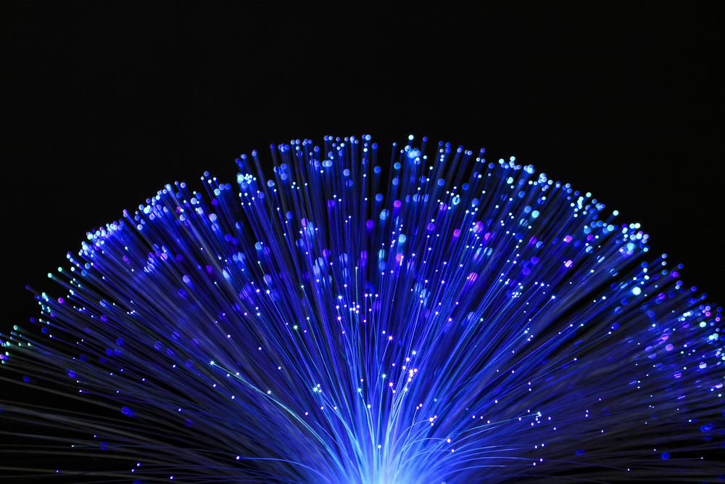
Optical fibres use total internal reflection to carry signals.
Optical fibres are made of glass fibres 10 micrometres thick, designed so the rays of light are totally internally reflected back into the glass. In this way, they can carry a signal over a long distance.
Most phone and internet cables now use fibre optics. They are also used in medical technology to observe regions of the body that are difficult to reach. For example, optical fibres can enable microsurgery using high-intensity laser beams.

Slide 18
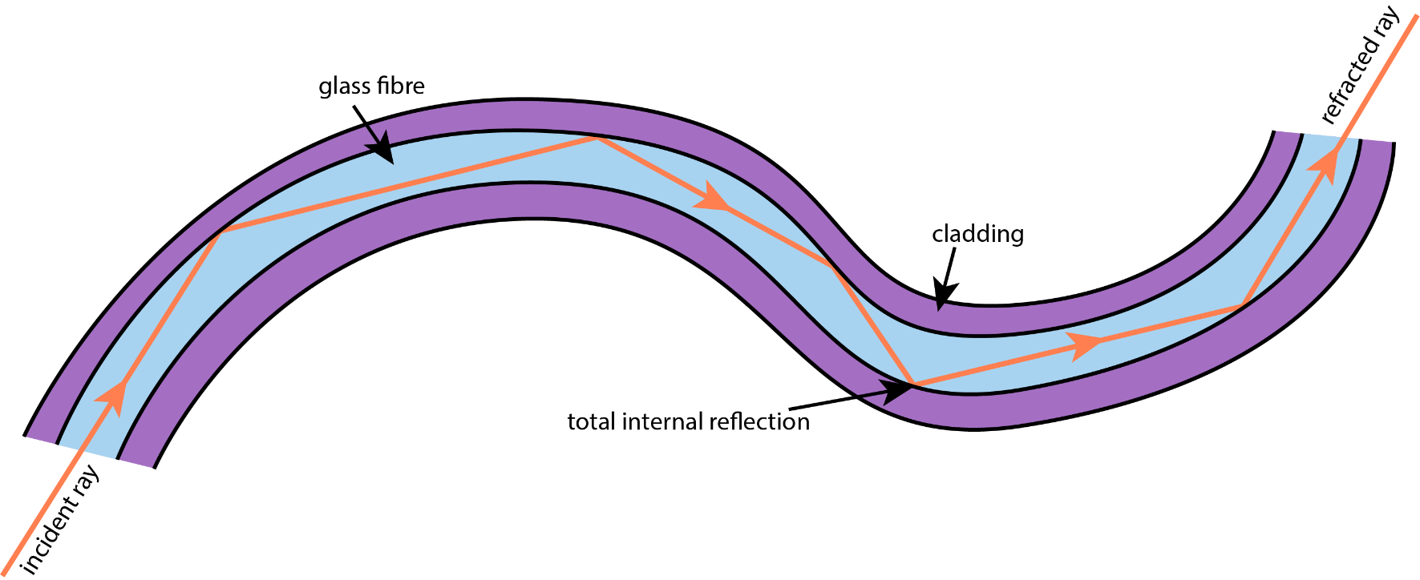
It is important in fibre optics to minimise the loss of light from the fibres.
We use fibres in bundles, with a cladding material to prevent transmission between them. The cladding must have a lower refractive index than the fibres, so that total internal reflection can occur.
Because the fibres have a refractive index that is much higher than that of the cladding, most of the light is propagated along them by total internal reflection. This allows a communication method which minimises loss of signal while remaining flexible and durable.

Slide 19
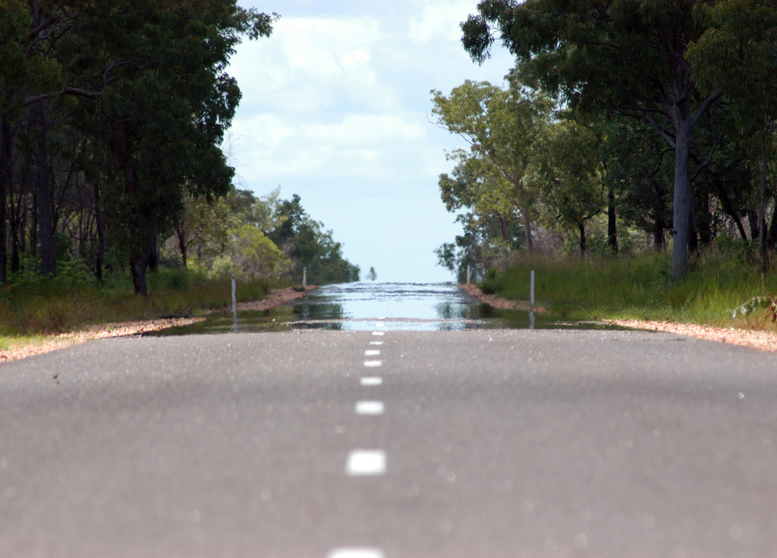
The refractive index of air decreases with temperature.
This means that under certain atmospheric conditions, total internal reflection can occur within the air itself. When hot ground heats the air above it, you may see a mysterious phenomenon: a mirage!
Mirages usually occur on hot, flat ground, such as desert sands or tarmac roads. They commonly look like a pool of water on the ground, but if you move closer, the mirage moves further away, or even disappears altogether. What’s happening?

Slide 20
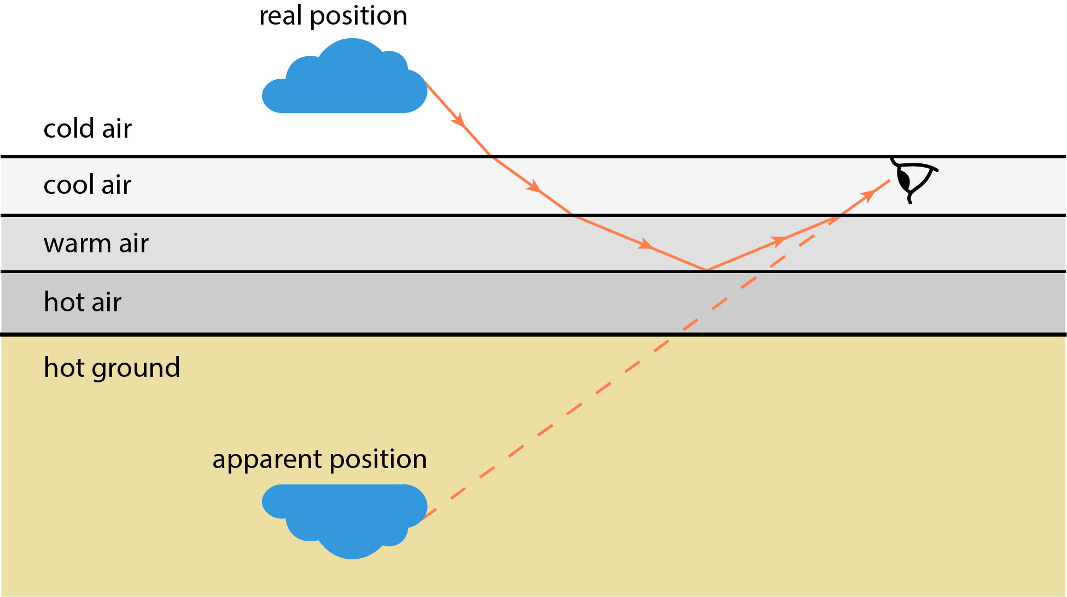
Refraction doesn’t necessarily occur at distinct boundaries.
In the case of a mirage, light refracts increasingly with hotter air, until it reaches the critical angle and total internal reflection occurs. The light reflects, then undergoes the same continuous refraction in the other direction, resulting in a curved path overall.
Light from the sky, or from distant objects, encounters hot air near the ground and totally internally reflects in this way. Your eye interprets light coming to it as moving in a straight line, so you see a patch of blue or an upside-down object on the ground. The most obvious interpretation is a pool of water.

